Slide 1
AWS Disaster Recovery Strategy and Implementation for Business Continuity

Slide 2
Agenda
Provide a robust disaster recovery solution using AWS
Ensure low downtime and business continuity
Implement industry best practices in backup, failover, and monitoring

Slide 3
Deliverables Overview
✅ Deliverable 1: Prerequisites for DR
Identified critical services: S3 (frontend), Lambda (logic), DynamoDB (data).
Defined RTO and RPO objectives.
Considered security roles and basic compliance needs.
✅ Deliverable 2: Cross-Region DR Setup
Primary Region: us-east-2 | DR Region: us-west-1.
Duplicated S3, Lambda, API Gateway, and DynamoDB manually.
Monitoring set up via CloudWatch Logs and Alarms.

Slide 4
✅ Deliverable 3: Backup Best Practices
DynamoDB backup/restore used for data replication.
S3 objects copied to DR region.
Enabled encryption on resources by default.
Backup integrity tested manually.

Slide 5
Preliminary Assessments
Risk Identified: Regional failure in us-east-2 affecting S3, Lambda, API Gateway, and DynamoDB.
Critical Components:
S3 (static website)
Lambda (Insert/Get Student)
DynamoDB (student data)
API Gateway (API access)
Business Impact:
UI inaccessible if S3 fails.
No data operations if Lambda/API fail.
DECISIONS:
All components replicated to us-west-1 for continuity

Slide 6





Compliance, Resources & Roles
IAM roles with least privilege
Encryption enabled (S3, DynamoDB)
Resources: S3, Lambda, DynamoDB, API Gateway
APPLICATION FLOW AND RESOURCES :
GET
USER
S3
API
dynamoDB
POST

Slide 7
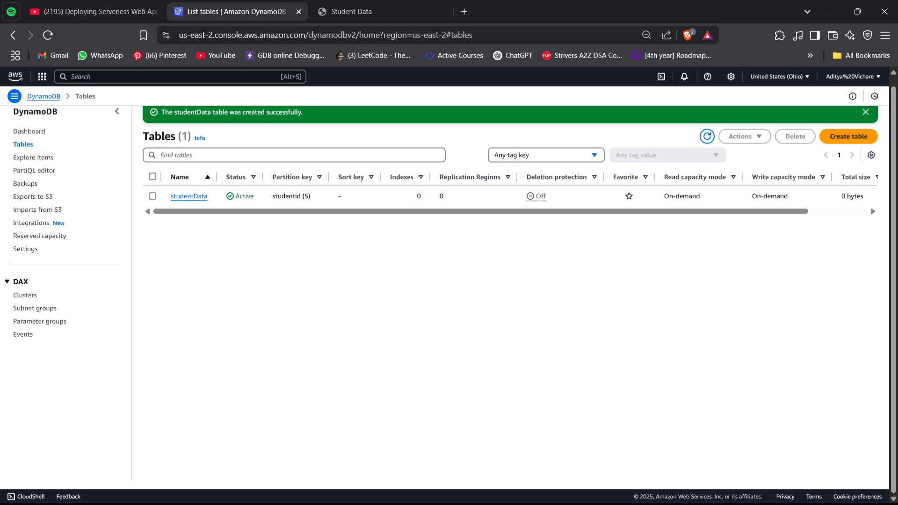
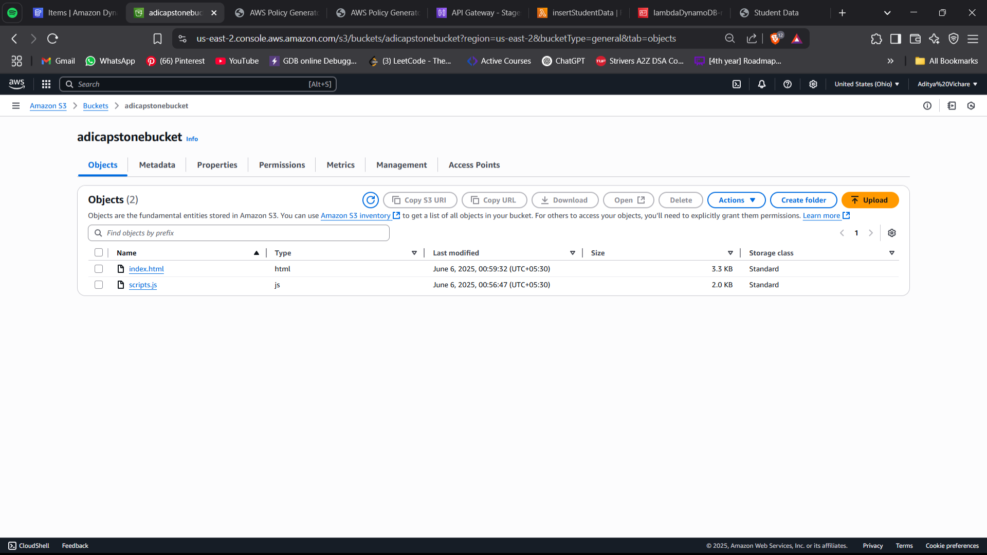
Created a table studentData in dynamoDB
Created a bucket to store objects

Slide 8
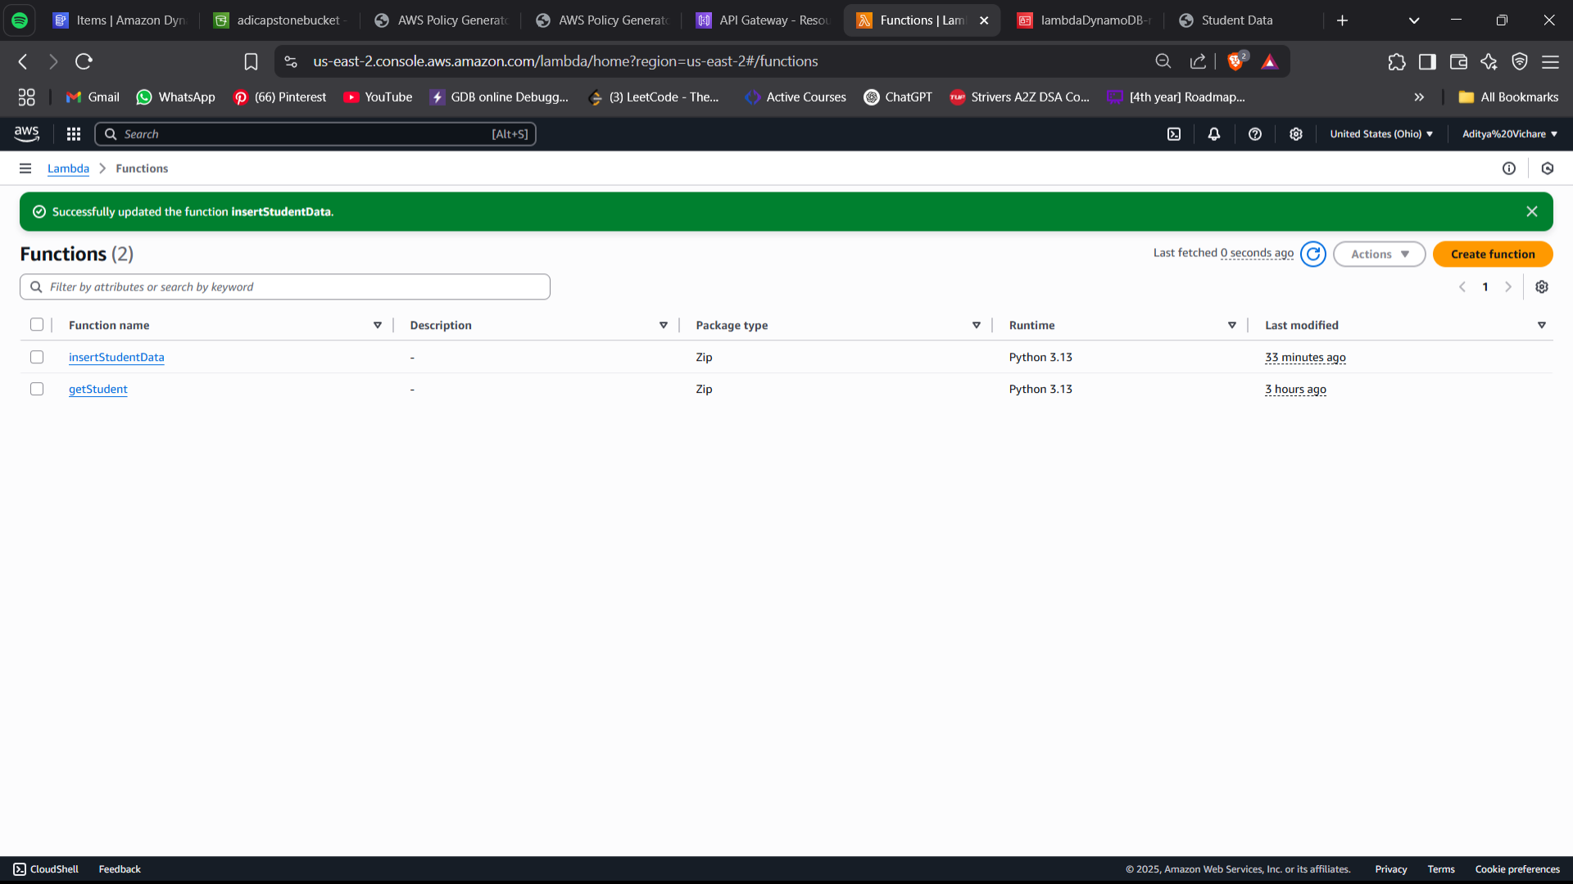
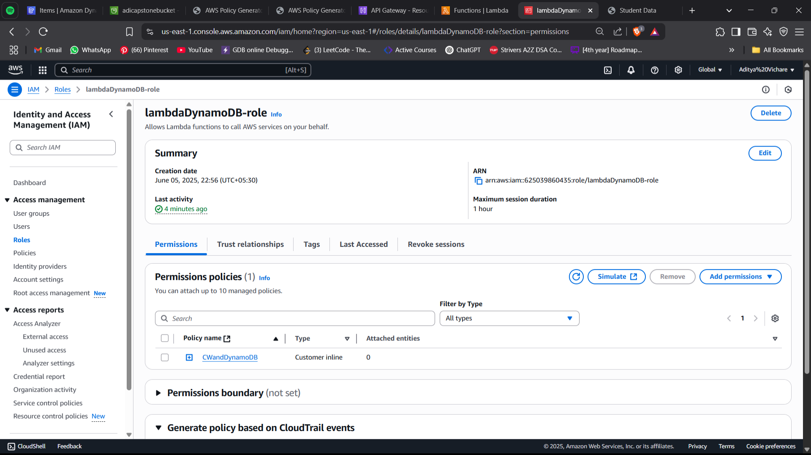
Created lambda functions in AWS lambda
Created a IAM role with least privileges

Slide 9
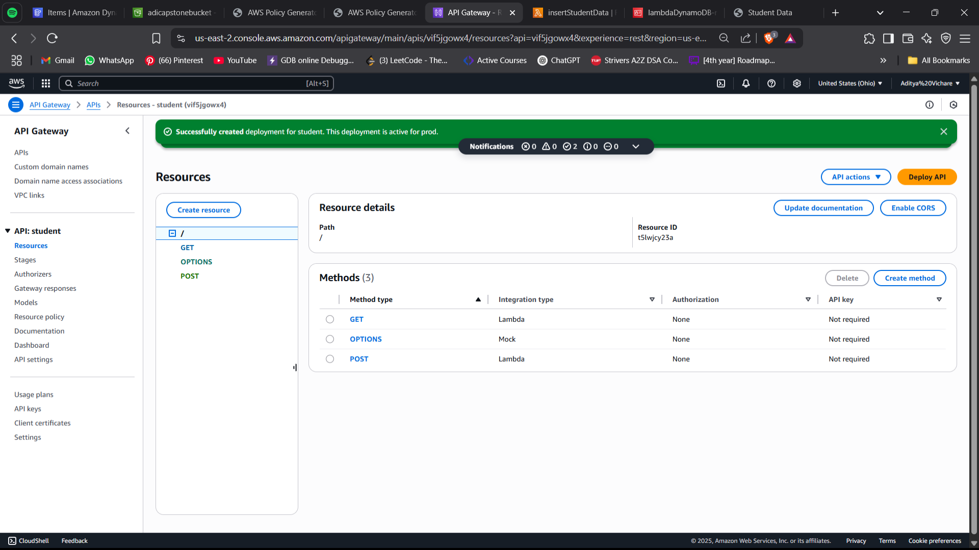
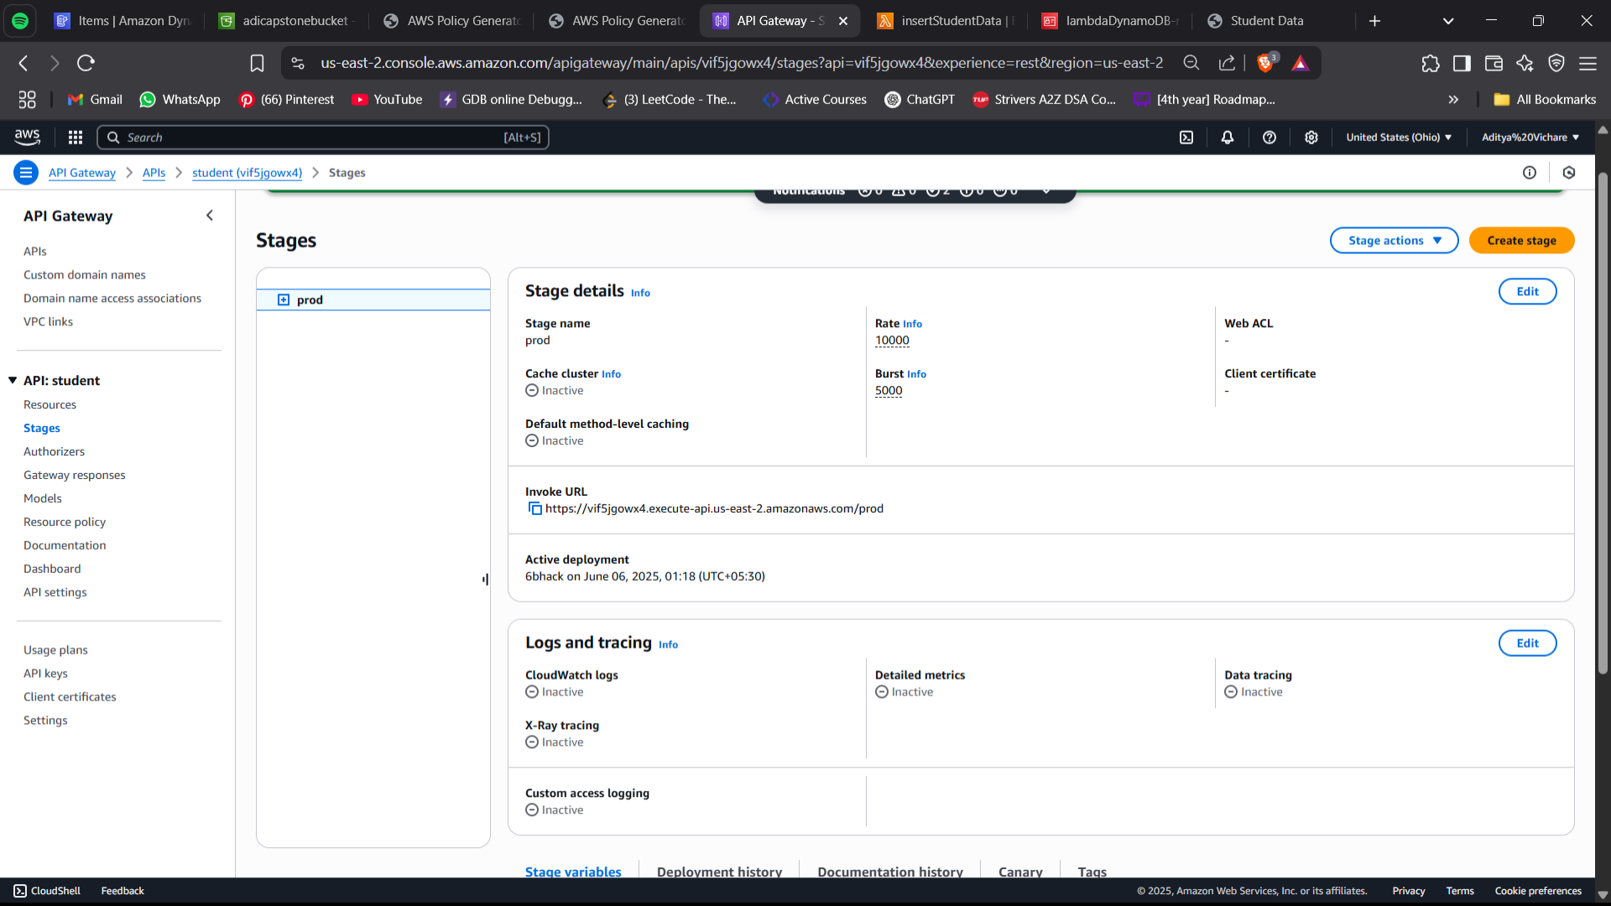

Slide 10
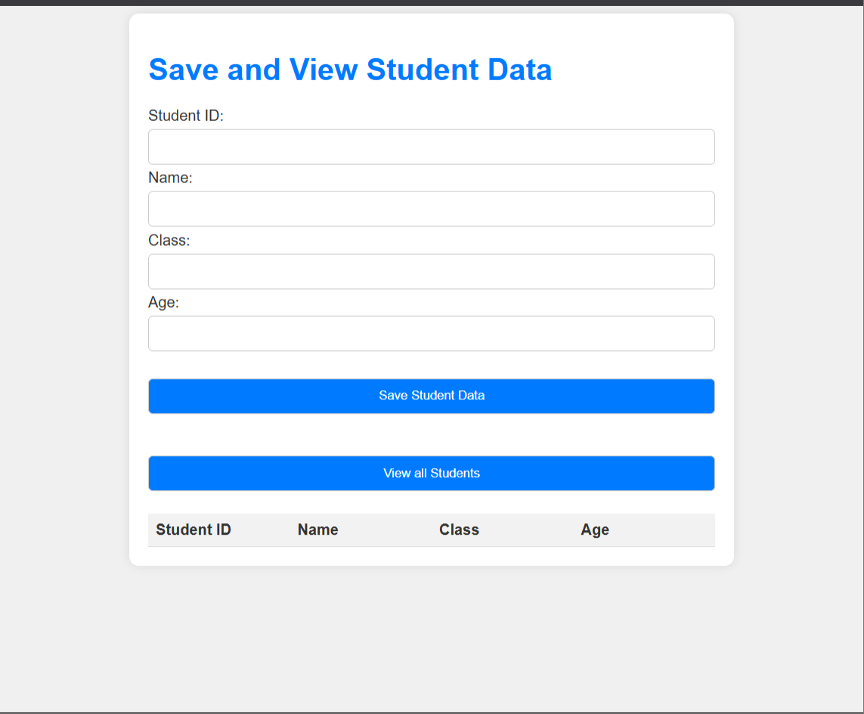
Frontend working in Primary region

Slide 11
Cross-Region DR Setup
🌍 Primary Region: us-east-2 (Ohio)
Initial deployment of all services:
S3 (Frontend)
Lambda (Backend Functions)
API Gateway
DynamoDB (Database)
🧭 Disaster Recovery Region: us-west-1 (N. California)
Chosen for:
✅ Geographic Separation – reduces impact of localized outages
✅ Low Latency – supports near real-time sync and failover
✅ Availability – ensures high uptime during primary failure

Slide 12
✅ Infrastructure Deployment
Replicated all resources manually to DR region:
S3 (copied via Batch job)
Lambda (same code, env vars updated)
API Gateway (same methods)
DynamoDB (restored from backup)

Slide 13
Recovery Objectives
Recovery Time Objective (RTO): ≤ 15 Minutes
Goal: Restore application access quickly after a regional failure.
Achieved by pre-deploying identical infrastructure in the DR region (us-west-1).
📦 Recovery Point Objective (RPO): Near Real-Time
DynamoDB backups exported and restored to DR region manually.
S3 static content replicated using Batch Copy jobs.
Ensures minimal data loss in case of disruption.
✅ Testing
DR region manually tested by simulating primary API failure.

Slide 14
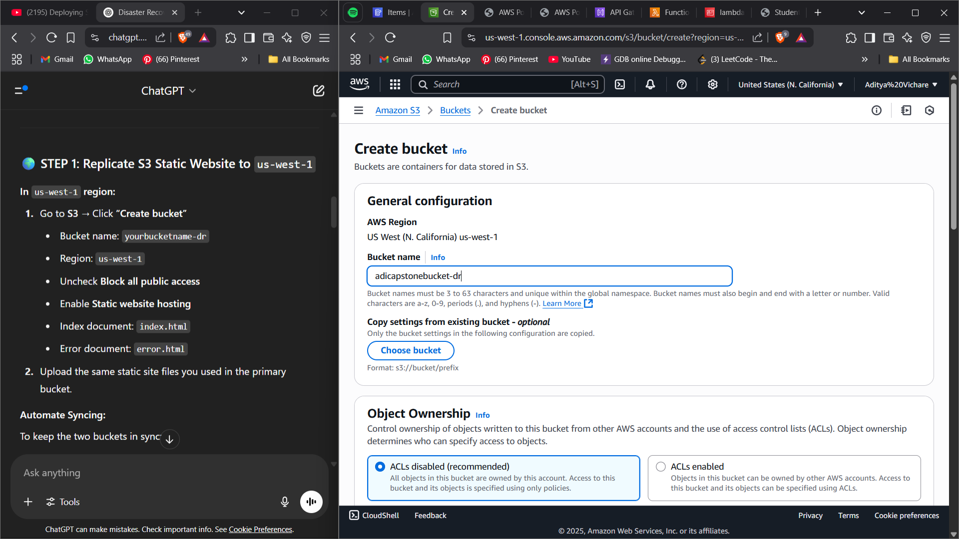

Slide 15
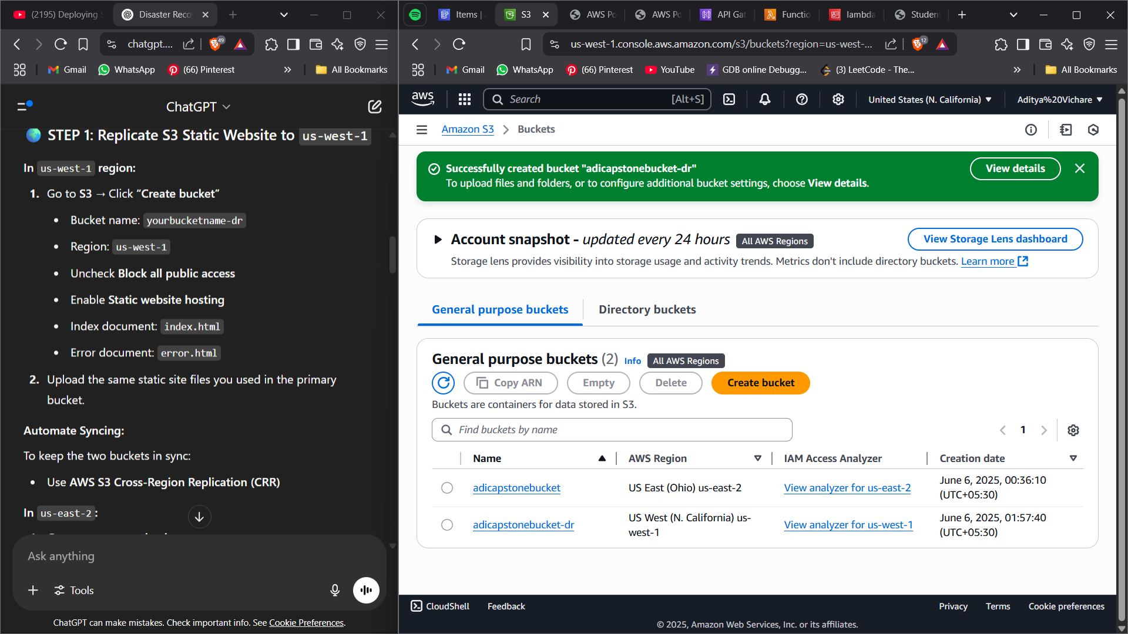
Created the Bucket backup in another region

Slide 16
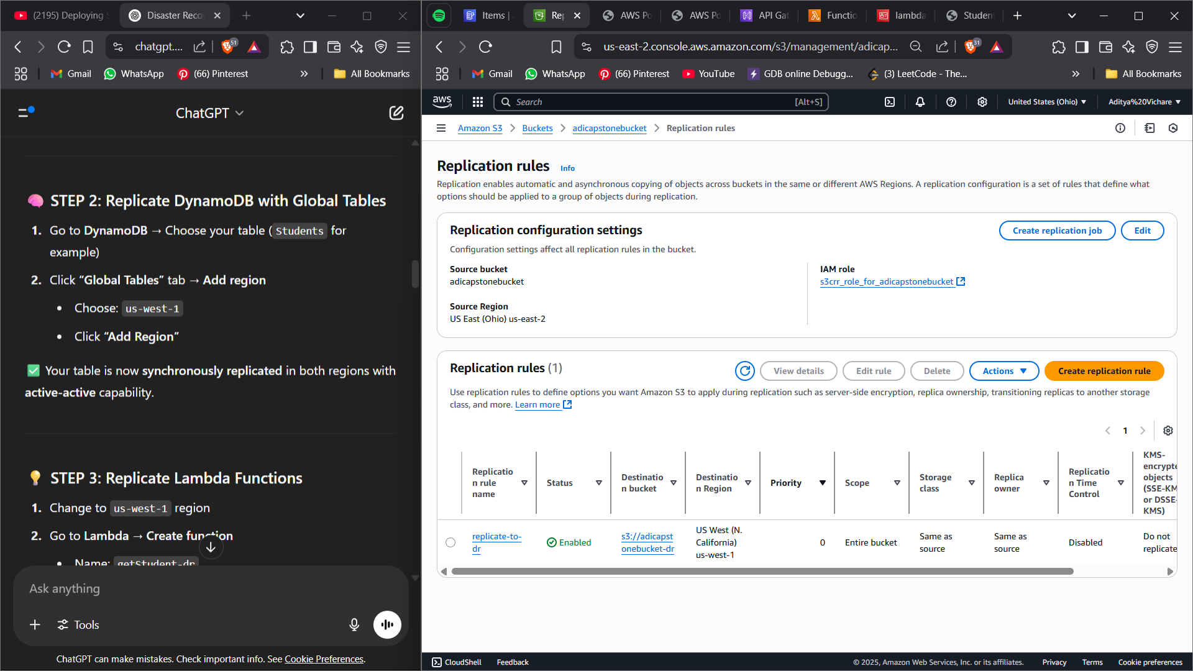

Slide 17
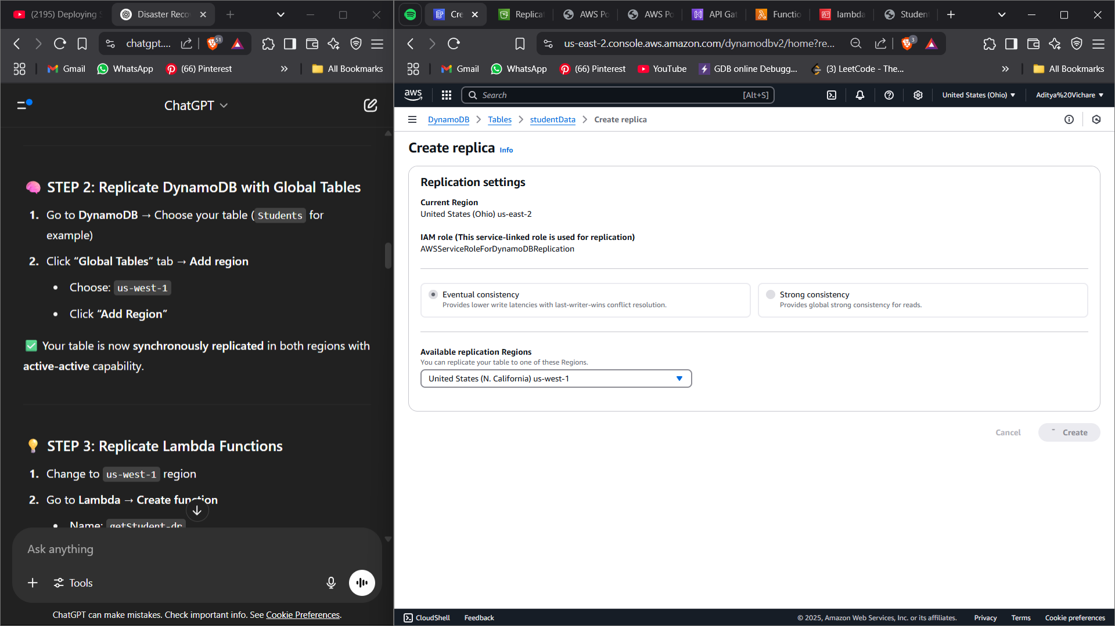
DynamoDB dr

Slide 18
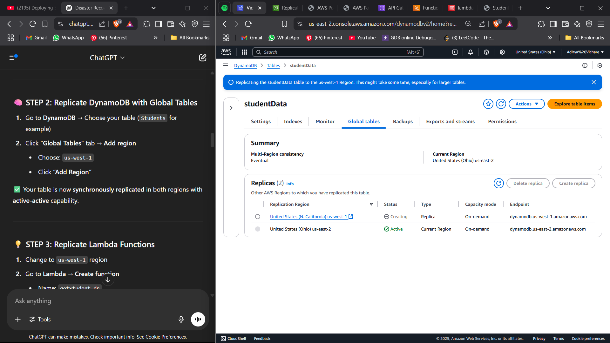
Created table replicas using global tables

Slide 19
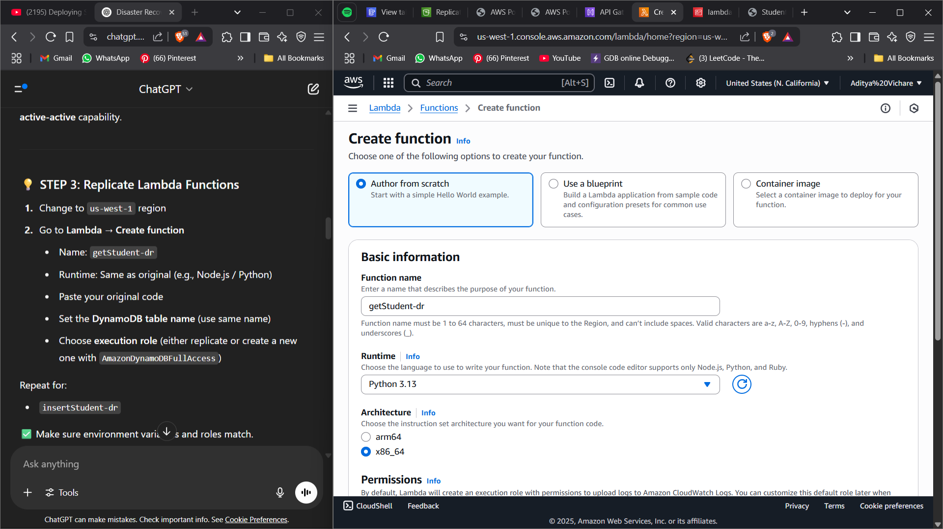
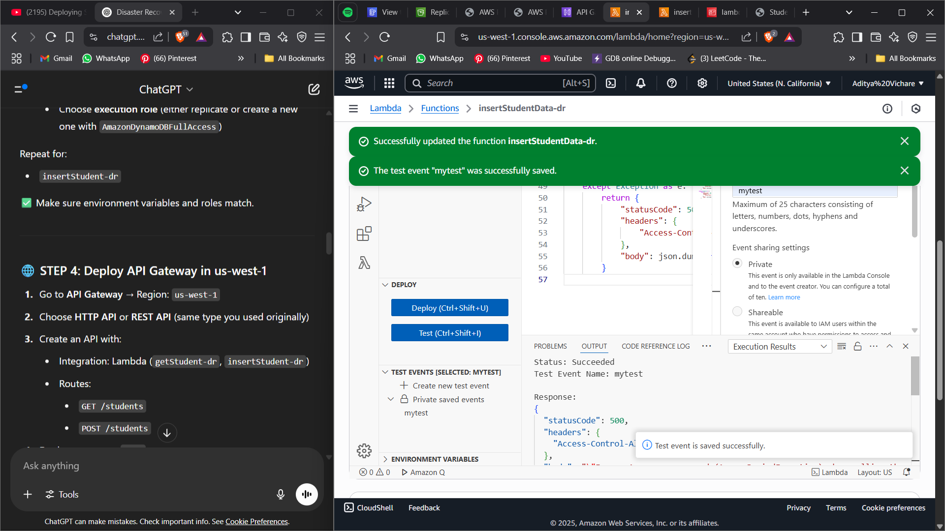
Created function backup in another region
Uploaded the same code in both the functions again ,Deployed and
tested again

Slide 20
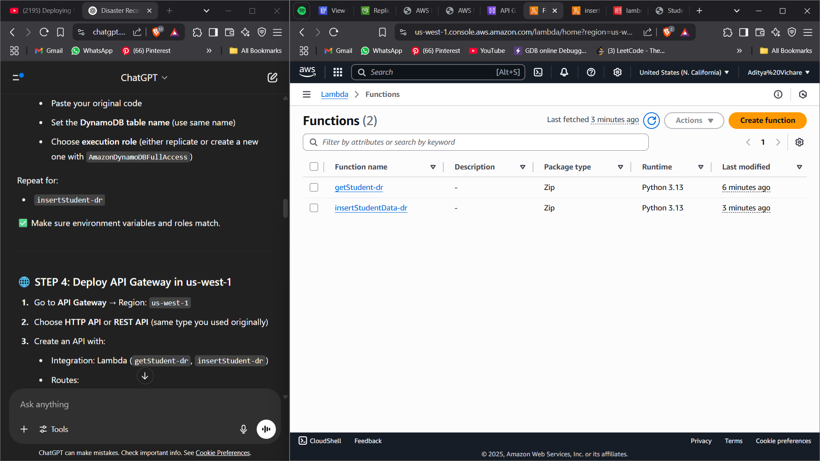

Slide 21
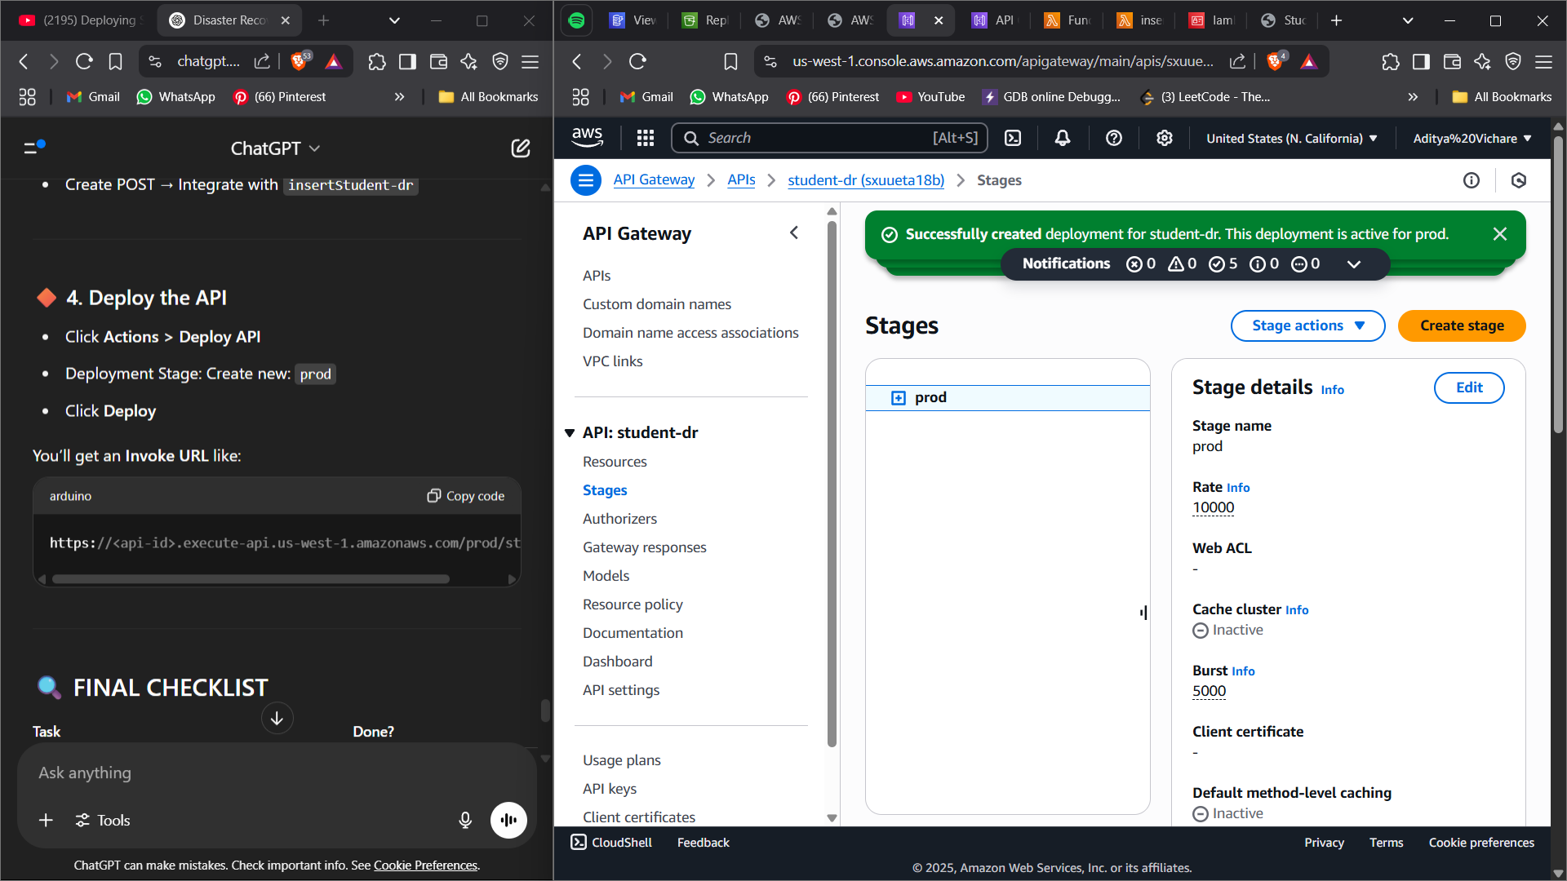
Replicated API Gateways

Slide 22
✅ Traffic Routing (Client-Side Fallback)
Initial Setup Summary:
Domain: adiawscapb.xyz purchased & registered.
Hosted static website via S3 buckets (Primary & Secondary regions).
Configured Route 53 hosted zone.
Attached domain name to S3 website hosting.
Ensured nameservers updated at domain registrar.

Slide 23
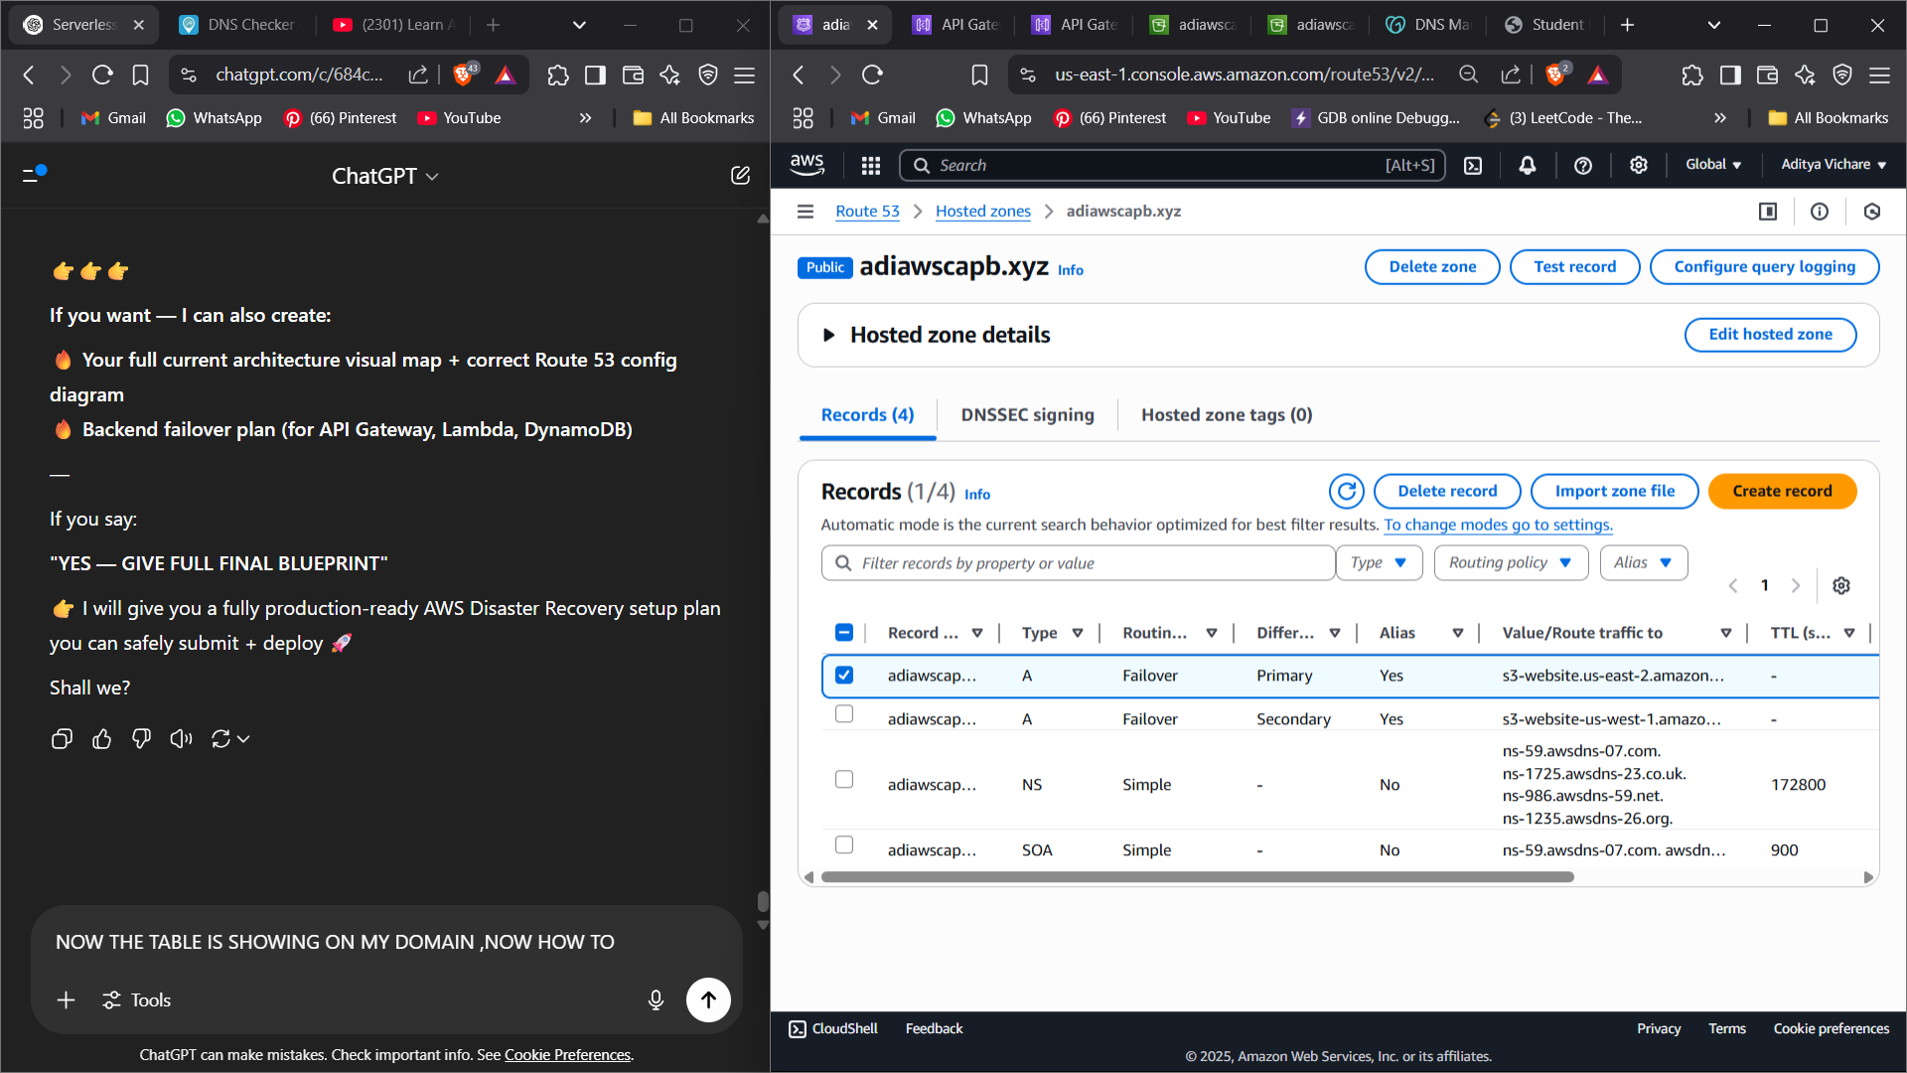
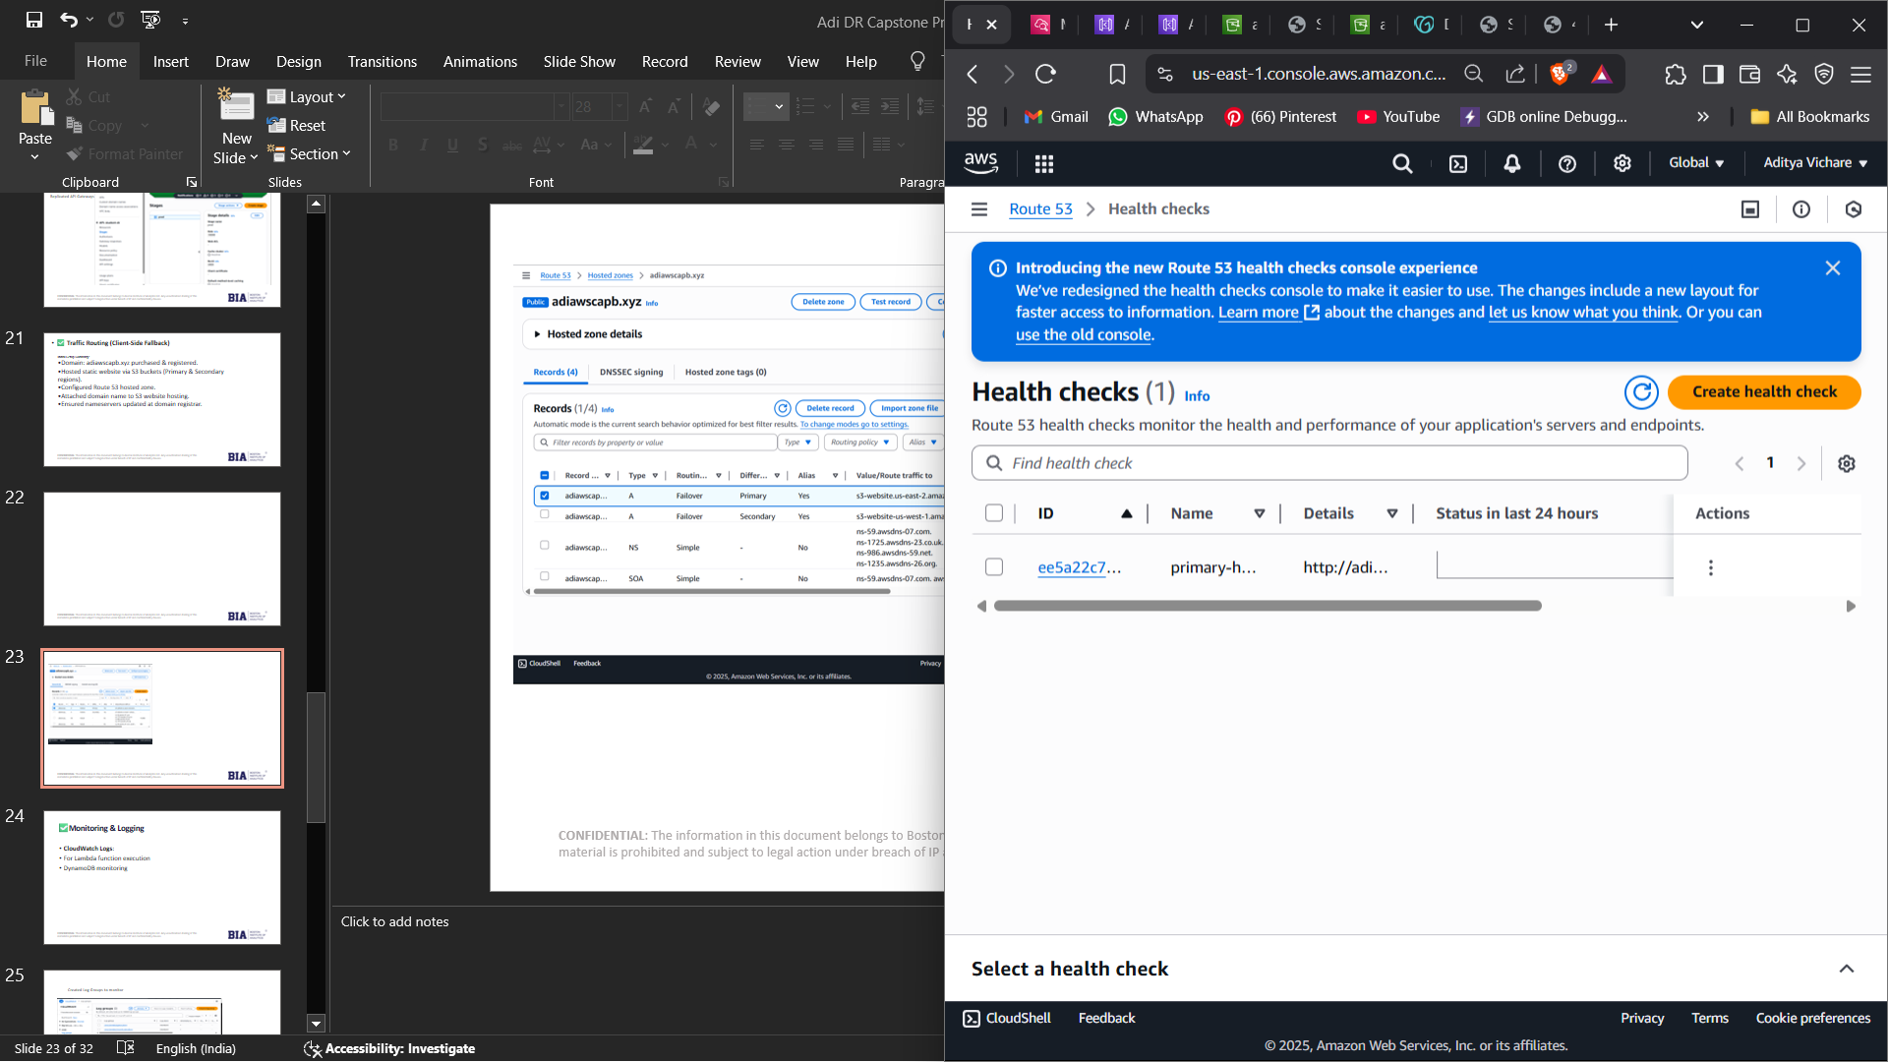

Slide 24
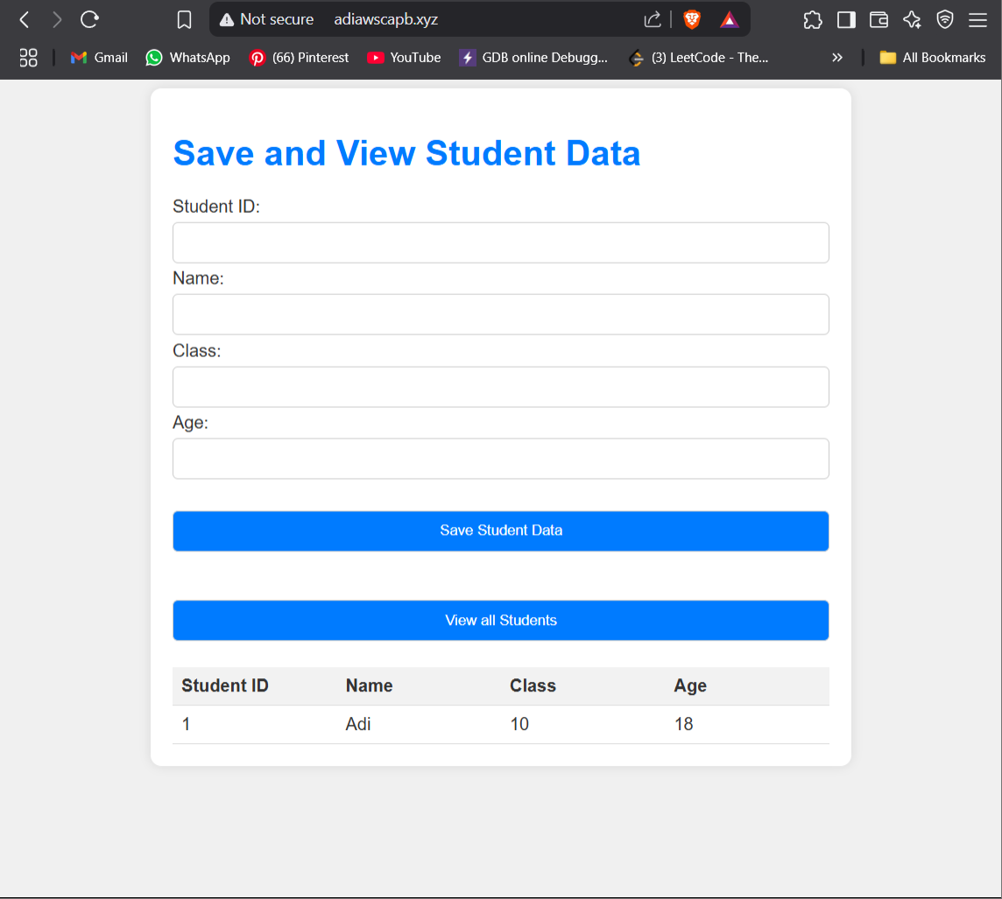
WEBSITE ACCESSED VIA THE
DOMAIN REGISTERED

Slide 25
✅Monitoring & Logging
CloudWatch Logs:
For Lambda function execution
DynamoDB monitoring

Slide 26
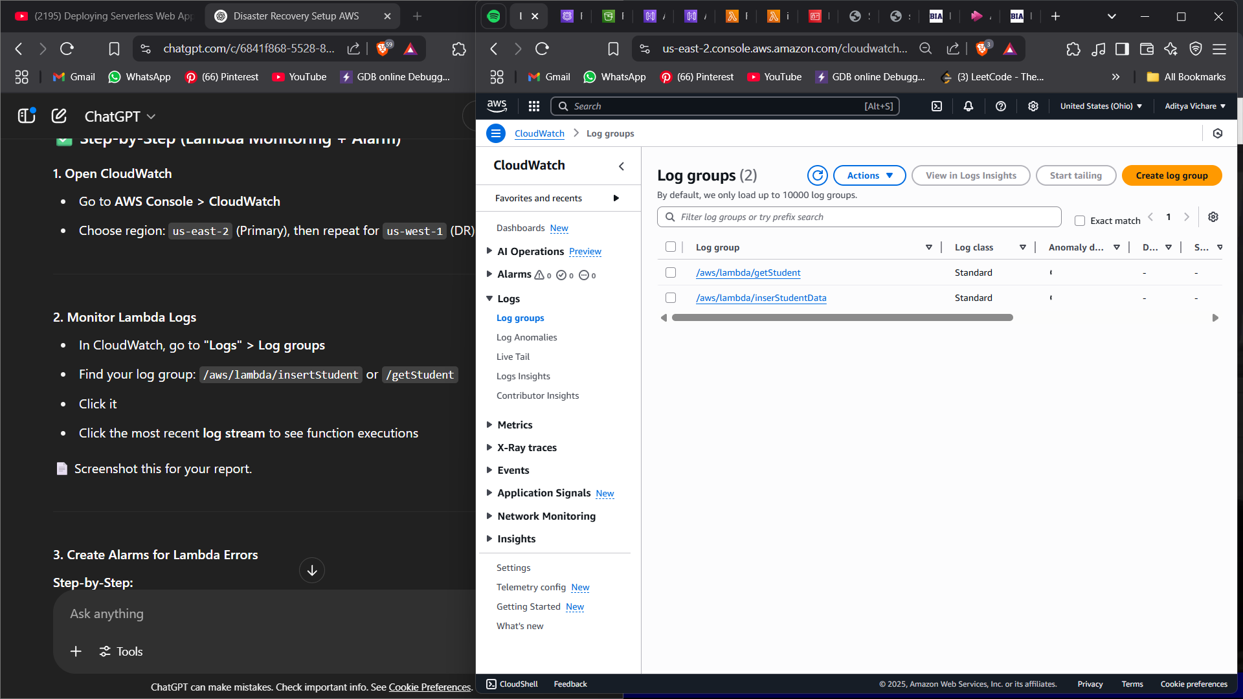
Created Log Groups to monitor

Slide 27
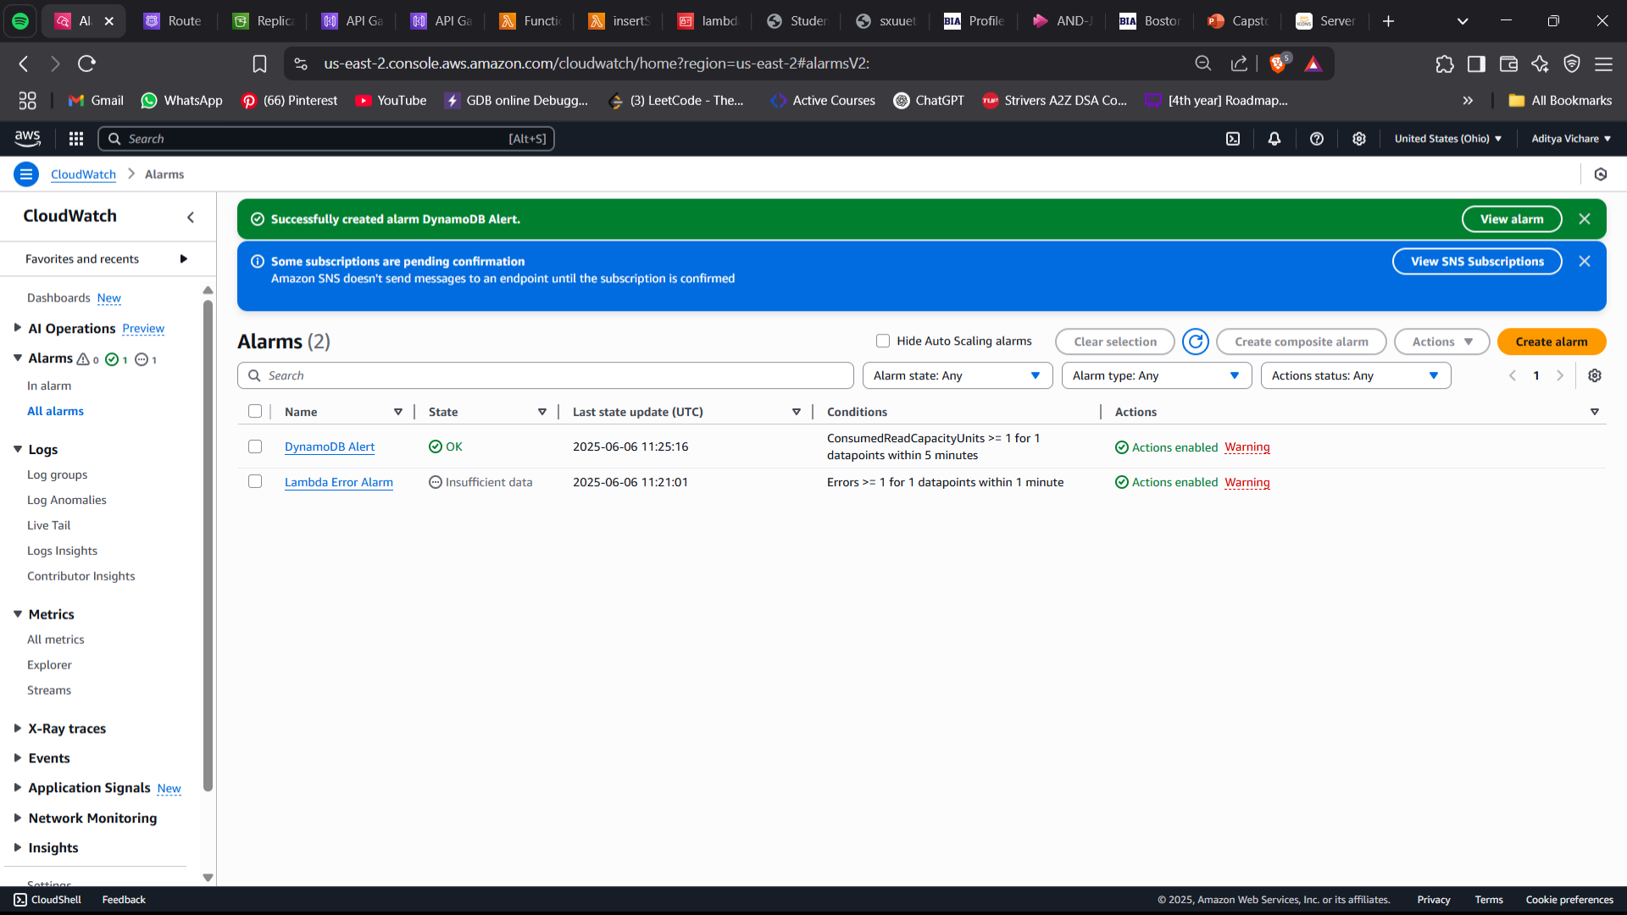
Created alarm and setup email for notifications

Slide 28

AFTER DR FLOW
Us-east-2(Primary region)
GET
USER
S3
API
dynamoDB
POST
Us-west-1 (Dr Region)
GET
S3
API
POST
dynamoDB

Slide 29
✅ DELIVERABLE 3: Backup Best Practices
On-Demand Export + Restore in DR Region
On-demand backup allows you to create full backups of your DynamoDB tables at any point in time.
Backups are stored in Amazon S3 and are independent of table availability or performance.
You can perform cross-region restore to a Disaster Recovery (DR) region, which ensures that if your primary AWS region is impacted (failure, outage, etc.), you can restore the table and resume operations from the DR region.
Exported data is versioned and timestamped to allow point-in-time recovery or rollback if necessary.
Benefits:
No performance impact on production tables during backup.
Can be integrated into a regular backup schedule (daily, weekly, monthly).

Slide 30
Option to Use Global Tables in Future
Global Tables is an active-active replication feature for DynamoDB.
Enables multi-region, fully managed, and fully replicated DynamoDB tables.
Real-time replication across regions.
Future enhancement plan:
To replace manual export + restore process with automatic replication.
Lower RTO (Recovery Time Objective) since Global Tables provide near-instant regional failover capability.
Useful for high-availability applications that require sub-second latency in multiple geographic locations.

Slide 31
S3 (Amazon Simple Storage Service)
Batch Copy for Static File Syncing
Regular batch copy jobs are scheduled to sync static files (images, videos, documents) across regions or buckets.
Typically used for:
DR purposes
Data archival
Cross-region content delivery
Batch copy can be implemented using:
AWS S3 Batch Operations (native service)
AWS DataSync or custom scripts using AWS Lambda functions.
Copy strategy:
Full sync weekly or monthly depending on file size and change frequency.
Incremental sync (copy only changed/new files) can be done daily.
Benefits:
Maintains redundancy and ensures availability even if primary S3 bucket or region is impacted.
Static files are easily restorable and versioning can be enabled for rollback to previous versions.

Slide 32
Questions ?

Slide 33
Thank You!

